Slide 1
Data Models

Slide 2
Objectives
Why data models are important
About the basic data-modeling building blocks
What business rules are and how they influence database design
How the major data models evolved
How data models can be classified by level of abstraction

Slide 3
The Importance of Data Models
Data models
  Relatively simple representations, usually graphical, of complex real-world data structures
  Facilitate interaction among the designer, the applications programmer, and the end user

Slide 4
The Importance of Data Models (continued)
End-users have different views and needs for data
Data model organizes data for various users

Slide 5
Data Model Basic Building Blocks
Entity - anything about which data are to be collected and stored
Attribute - a characteristic of an entity
Relationship - describes an association among entities
  One-to-many (1:M) relationship
  Many-to-many (M:N or M:M) relationship
  One-to-one (1:1) relationship
Constraint - a restriction placed on the data

Slide 6
Business Rules
Brief, precise, and unambiguous descriptions of a policies, procedures, or principles within a specific organization
Apply to any organization that stores and uses data to generate information
Description of operations that help to create and enforce actions within that organization’s environment

Slide 7
Business Rules (continued)
Must be rendered in writing
Must be kept up to date
Sometimes are external to the organization
Must be easy to understand and widely disseminated
Describe characteristics of the data as viewed by the company

Slide 8
Discovering Business Rules
Sources of Business Rules:
Company managers
Policy makers
Department managers
Written documentation
  Procedures
  Standards
  Operations manuals
Direct interviews with end users

Slide 9
Translating Business Rules into Data Model Components
Standardize company’s view of data
Constitute a communications tool between users and designers
Allow designer to understand the nature, role, and scope of data
Allow designer to understand business processes
Allow designer to develop appropriate relationship participation rules and constraints
Promote creation of an accurate data model

Slide 10
Discovering Business Rules (continued)
Generally, nouns translate into entities
Verbs translate into relationships among entities
Relationships are bi-directional

Slide 11
The Evolution of Data Models (continued)
Hierarchical
Network
Relational
Entity relationship
Object oriented (OO)

Slide 12
The Hierarchical Model
Developed in the 1960s to manage large amounts of data for complex manufacturing projects
Basic logical structure is represented by an upside-down “tree”

Slide 13
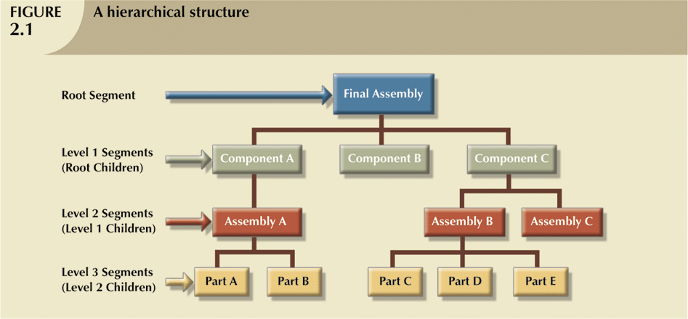
The Hierarchical Model (continued)

Slide 14
The Hierarchical Model (continued)
The hierarchical structure contains levels, or segments
Depicts a set of one-to-many (1:M) relationships between a parent and its children segments
  Each parent can have many children
  each child has only one parent

Slide 15
The Hierarchical Model (continued)
Advantages
  Many of the hierarchical data model’s features formed the foundation for current data models
  Its database application advantages are replicated, albeit in a different form, in current database environments
  Generated a large installed (mainframe) base, created a pool of programmers who developed numerous tried-and-true business applications

Slide 16
The Hierarchical Model (continued)
Disadvantages
  Complex to implement
  Difficult to manage
  Lacks structural independence
  Implementation limitations
  Lack of standards

Slide 17
The Network Model
Created to
  Represent complex data relationships more effectively
  Improve database performance
  Impose a database standard
Conference on Data Systems Languages (CODASYL)
Database Task Group (DBTG)

Slide 18
The Network Model (continued)
Schema
  Conceptual organization of entire database as viewed by the database administrator
Subschema
  Defines database portion “seen” by the application programs that actually produce the desired information from data contained within the database
Data Management Language (DML)
  Defines the environment in which data can be managed

Slide 19
The Network Model (continued)
Schema Data Definition Language (DDL)
  Enables database administrator to define schema components
Subschema DDL
  Allows application programs to define database components that will be used
DML
  Works with the data in the database

Slide 20
The Network Model (continued)
Resembles hierarchical model
Collection of records in 1:M relationships
Set
  Relationship
  Composed of at least two record types
    Owner
      Equivalent to the hierarchical model’s parent
    Member
      Equivalent to the hierarchical model’s child

Slide 21
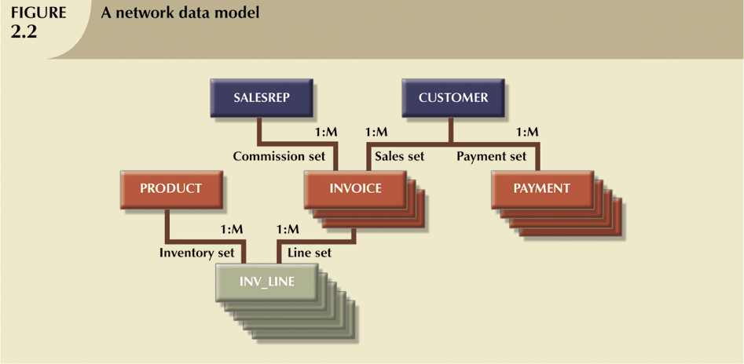
The Network Model (continued)

Slide 22
The Network Model (continued)
Disadvantages
  Too cumbersome
  The lack of ad hoc query capability put heavy pressure on programmers
  Any structural change in the database could produce havoc in all application programs that drew data from the database
  Many database old-timers can recall the interminable information delays

Slide 23
The Relational Model
Developed by Codd (IBM) in 1970
Considered ingenious but impractical in 1970
Conceptually simple
Computers lacked power to implement the relational model
Today, microcomputers can run sophisticated relational database software

Slide 24
The Relational Model (continued)
Relational Database Management System (RDBMS)
Performs same basic functions provided by hierarchical and network DBMS systems, in addition to a host of other functions
Most important advantage of the RDBMS is its ability to hide the complexities of the relational model from the user

Slide 25
The Relational Model (continued)
Table (relations)
  Matrix consisting of a series of row/column intersections
  Related to each other through sharing a common entity characteristic
Relational diagram
  Representation of relational database’s entities, attributes within those entities, and relationships between those entities

Slide 26
The Relational Model (continued)
Relational Table
  Stores a collection of related entities
    Resembles a file
Relational table is purely logical structure
  How data are physically stored in the database is of no concern to the user or the designer
  This property became the source of a real database revolution

Slide 27
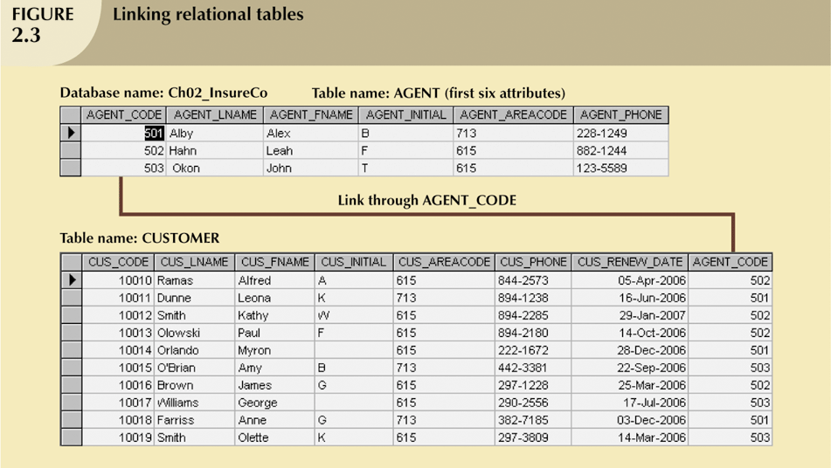
The Relational Model (continued)

Slide 28
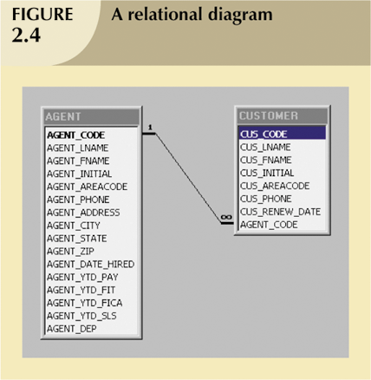
The Relational Model (continued)

Slide 29
The Relational Model (continued)
Rise to dominance due in part to its powerful and flexible query language
Structured Query Language (SQL) allows the user to specify what must be done without specifying how it must be done
SQL-based relational database application involves:
  User interface
  A set of tables stored in the database
  SQL engine

Slide 30
The Entity Relationship Model
Widely accepted and adapted graphical tool for data modeling
Introduced by Chen in 1976
Graphical representation of entities and their relationships in a database structure

Slide 31
The Entity Relationship Model (continued)
Entity relationship diagram (ERD)
  Uses graphic representations to model database components
  Entity is mapped to a relational table
Entity instance (or occurrence) is row in table
Entity set is collection of like entities
Connectivity labels types of relationships
  Diamond connected to related entities through a relationship line

Slide 32
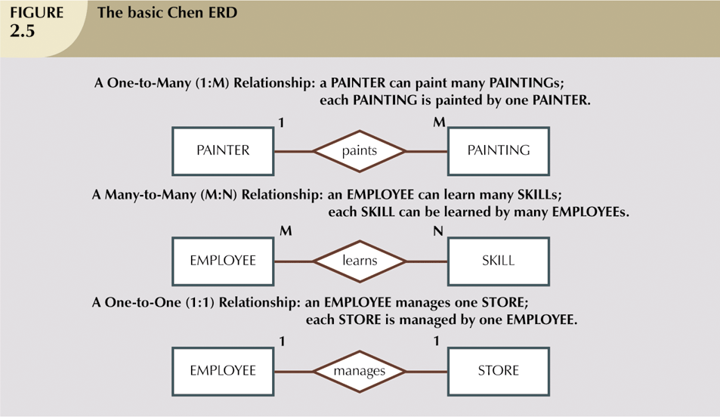
The Entity Relationship Model (continued)

Slide 33
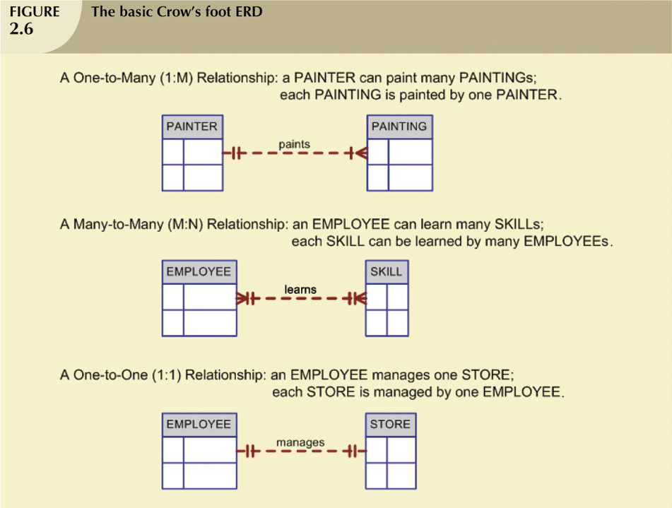
The Entity Relationship Model (continued)

Slide 34
The Object Oriented Model
Modeled both data and their relationships in a single structure known as an object
Object-oriented data model (OODM) is the basis for the object-oriented database management system (OODBMS)
OODM is said to be a semantic data model

Slide 35
The Object Oriented Model (continued)
Object described by its factual content
  Like relational model’s entity
Includes information about relationships between facts within object, and relationships with other objects
  Unlike relational model’s entity
Subsequent OODM development allowed an object to also contain all operations
Object becomes basic building block for autonomous structures

Slide 36
The Object Oriented Model (continued)
Object is an abstraction of a real-world entity
Attributes describe the properties of an object
Objects that share similar characteristics are grouped in classes
Classes are organized in a class hierarchy
Inheritance is the ability of an object within the class hierarchy to inherit the attributes and methods of classes above it

Slide 37
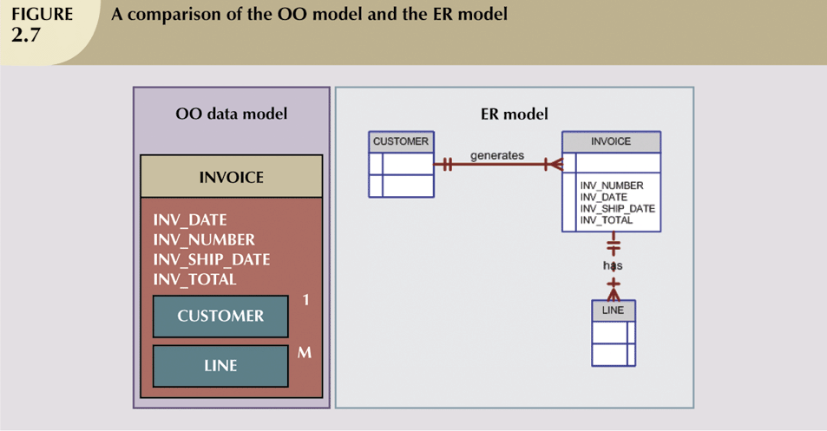
The Object Oriented Model (continued)

Slide 38
Other Models
Extended Relational Data Model (ERDM)
  Semantic data model developed in response to increasing complexity of applications
  DBMS based on the ERDM often described as an object/relational database management system (O/RDBMS)
  Primarily geared to business applications

Slide 39
Database Models and the Internet
Internet drastically changed role and scope of database market
OODM and ERDM-O/RDM have taken a backseat to development of databases that interface with Internet
Dominance of Web has resulted in growing need to manage unstructured information

Slide 40
Data Models: A Summary
Each new data model capitalized on the shortcomings of previous models
Common characteristics:
  Conceptual simplicity without compromising the semantic completeness of the database
  Represent the real world as closely as possible
  Representation of real-world transformations (behavior) must comply with consistency and integrity characteristics of any data model

Slide 41
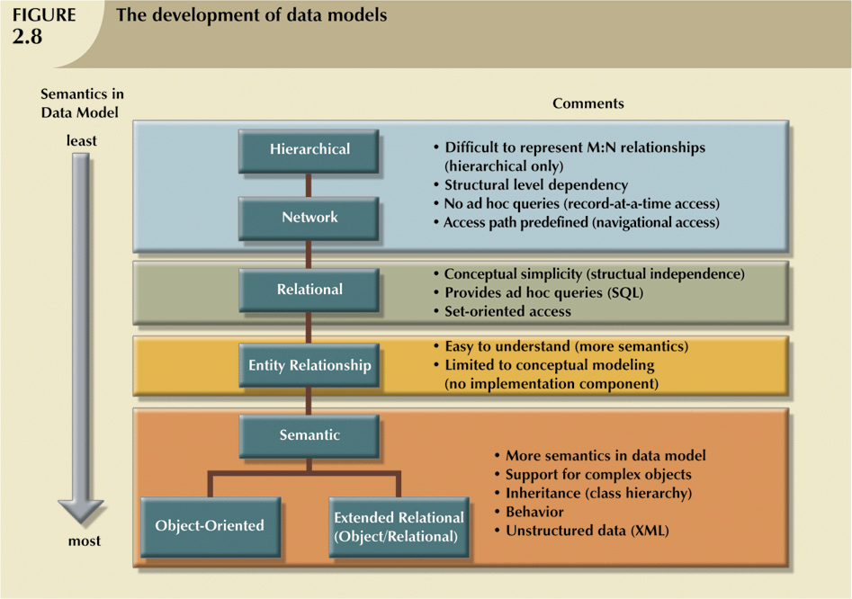
Data Models: A Summary (continued)

Slide 42
Degrees of Data Abstraction
Way of classifying data models
Many processes begin at high level of abstraction and proceed to an ever-increasing level of detail
Designing a usable database follows the same basic process

Slide 43
Degrees of Data Abstraction (continued)
American National Standards Institute (ANSI) Standards Planning and Requirements Committee (SPARC)
  Defined a framework for data modeling based on degrees of data abstraction(1970s):
    External
    Conceptual
    Internal

Slide 44
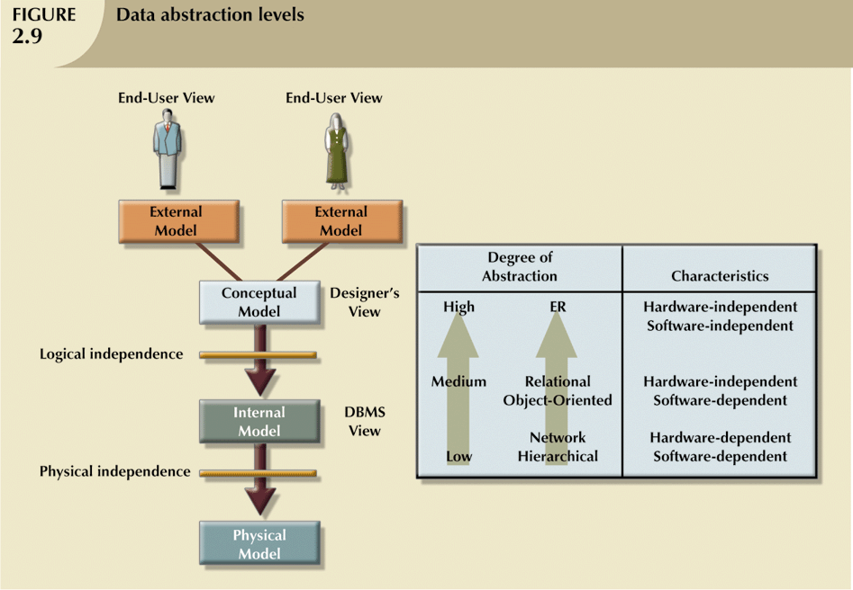
Degrees of Data Abstraction (continued)

Slide 45
The External Model
End users’ view of the data environment
Requires that the modeler subdivide set of requirements and constraints into functional modules that can be examined within the framework of their external models

Slide 46
The External Model (continued)
Advantages:
  Easy to identify specific data required to support each business unit’s operations
  Facilitates designer’s job by providing feedback about the model’s adequacy
  Creation of external models helps to ensure security constraints in the database design
  Simplifies application program development

Slide 47
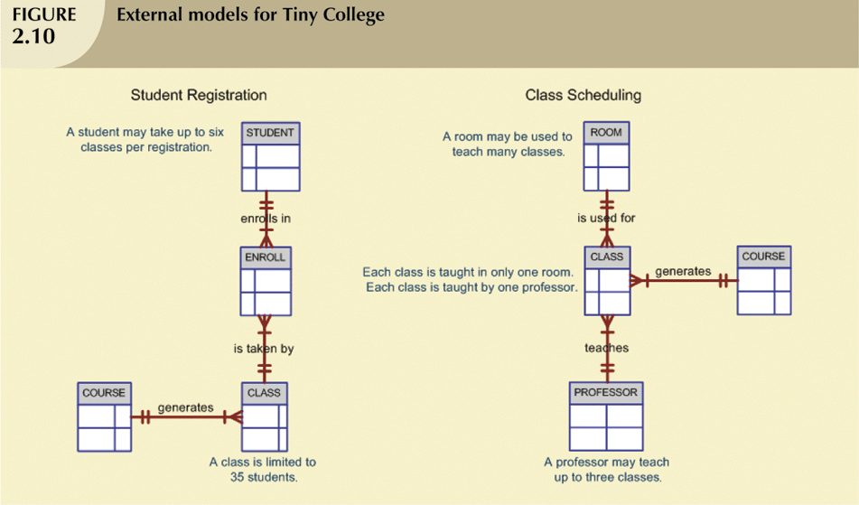
The External Model (continued)

Slide 48
The Conceptual Model
Represents global view of the entire database
Representation of data as viewed by the entire organization
Basis for identification and high-level description of main data objects, avoiding details
Most widely used conceptual model is the entity relationship (ER) model

Slide 49
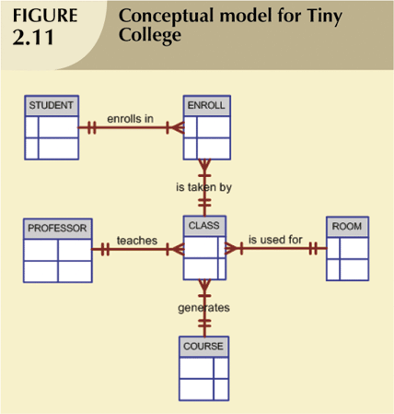
The Conceptual Model (continued)

Slide 50
The Conceptual Model (continued)
Provides a relatively easily understood macro level view of data environment
Independent of both software and hardware
  Does not depend on the DBMS software used to implement the model
  Does not depend on the hardware used in the implementation of the model
  Changes in either hardware or DBMS software have no effect on the database design at the conceptual level

Slide 51
The Internal Model
Representation of the database as “seen” by the DBMS
Maps the conceptual model to the DBMS
Internal schema depicts a specific representation of an internal model

Slide 52
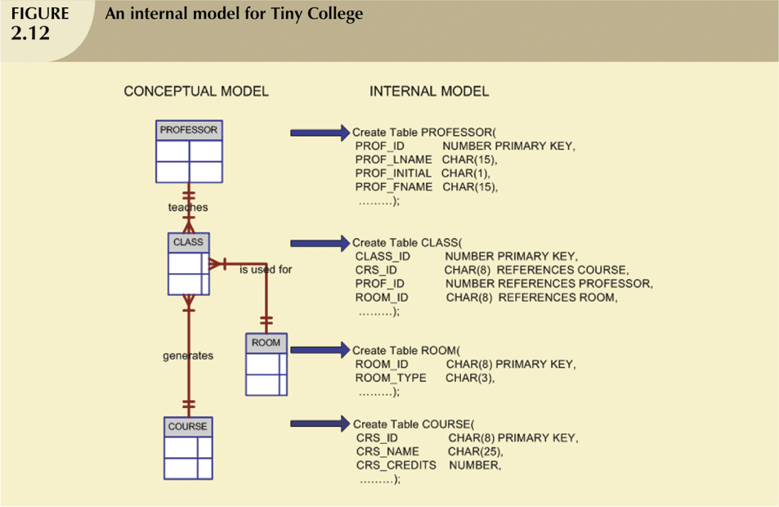
The Internal Model (continued)

Slide 53
The Physical Model
Operates at lowest level of abstraction, describing the way data are saved on storage media such as disks or tapes
Software and hardware dependent
Requires that database designers have a detailed knowledge of the hardware and software used to implement database design

Slide 54
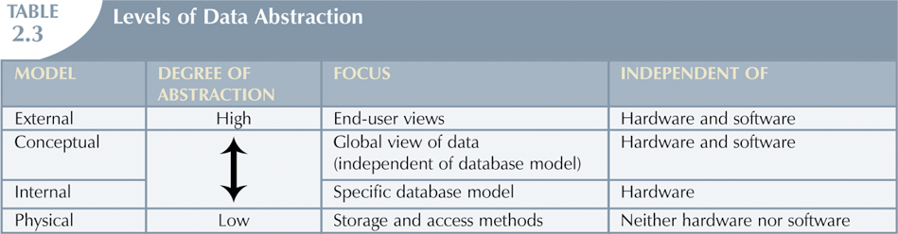
The Physical Model (continued)

Slide 55
Summary
A data model is a (relatively) simple abstraction of a complex real-world data environment
Basic data modeling components are:
  Entities
  Attributes
  Relationships
  Constraints

Slide 56
Summary (continued)
Hierarchical model
  Depicts a set of one-to-many (1:M) relationships between a parent and its children segments
Network data model
  Uses sets to represent 1:M relationships between record types
Relational model
  Current database implementation standard
  ER model is a popular graphical tool for data modeling that complements the relational model

Slide 57
Summary (continued)
Object is basic modeling structure of object oriented data model
The relational model has adopted many object-oriented extensions to become the extended relational data model (ERDM)
Data modeling requirements are a function of different data views (global vs. local) and level of data abstraction

